Slide 1
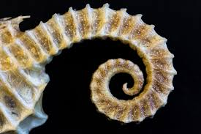
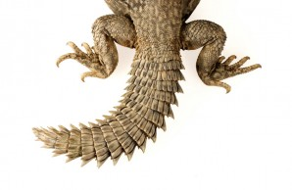

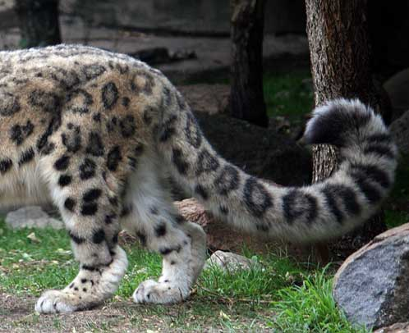

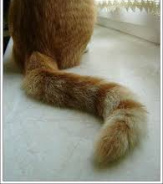
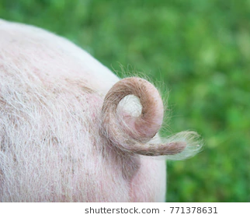
Tail Recursion
Chae & Mary

Slide 2
Tail Recursion: definitions
Tail context
Last action or evaluation step that a function does
Tail call
A function call in tail context
Tail recursion
Each recursive call must be the last thing that can happen in a function
Tail call optimization
Reuse the current frame for the new function call.
Saves memory as you don’t create a new frame.
Notes:
Chae

Slide 3
Recursion
f1: fact
n: 3
rv: .
We need to keep these frames open because the last step in the function is to multiply n with the result of the recursive call.
6
(define (fact n)
(if (= n 0)
1
(* n (fact (- n 1)))
)
)
f2: fact
n: 2
rv: .
2
f3: fact
n: 1
rv: .
1
f4: fact
n: 0
rv: 1
Consider a call to (fact 3)
Notes:
Chae

Slide 4
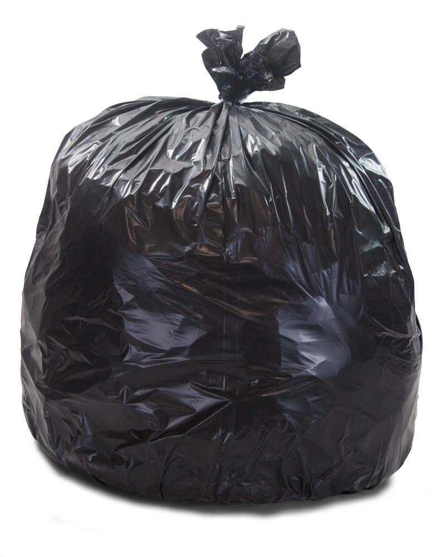
Tail Recursion = saves space!
f1: fact-tail
n: 2
result: 1
rv: (fact-tail 1 2)
f2: fact-tail
n: 1
result: 2
rv: (fact-tail 0 2).
(define (fact n)
(define (fact-tail n result)
(if (= n 0)
result
(fact-tail (- n 1) (* n result))
))
(fact-tail n 1)
)
f3: fact-tail
n: 0
result: 2
rv: result, which is 2
Consider a call to (fact 2)
Notes:
Chae
Discuss together, 1 min to code

Slide 5
Problem 1: tail recursive?
For the following procedures, determine whether or not they use a constant number of space (is it tail recursive?). If they are not, write why they aren’t.
(define (mult x y)
(if (= 0 y)
0
(+ x (mult x (- y 1))))
(define (true2 n)
(if (= n 0)
#t
(or (true (- n 1)) #f)))
Not tail recursive
2
(define (true1 n)
(if (= n 0)
#t
(and #t (true1 (- n 1)))))
Not tail recursive
Tail recursive
Notes:
Mary
Red boxes are the last expressions that are evaluated.
(mult x y) is not tail recursive because + is the last operation in the frame

Slide 6
Problem 1: tail recursive?
For the following procedures, determine whether or not they use a constant number of space (is it tail recursive?). If they are not, write why they aren’t.
(define (search b x)
(cond ((null? b ) #f)
((eq? (label b) x) #t)
((< (label t) x) (search (left b) x))
(else (search (right b) x))))
(define (contains lst x)
(cond ((null? lst) #f)
((equal? (car lst) x) #t)
((contains (cdr lst) x) #t)))))
Not tail recursive
Tail recursive
Notes:
Mary
Red boxes are the last expressions that are evaluated.
(contains lst x) is not tail recursive because #t is the last operation in the frame

Slide 7
Code Writing with Tail Recursion
Create a helper function
Think about solving the problem iteratively
Arguments in helper function should be the variables you keep track of during iteration
Base case in helper function should be termination case for iteration
Recursive call in helper function should update arguments like in iteration
Call helper function with initial values of variables
Notes:
Mary

Slide 8
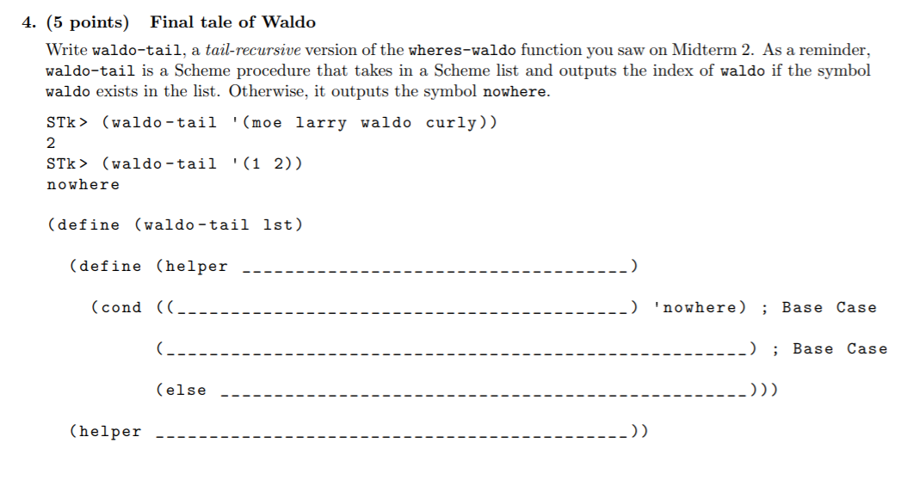
Notes:
Chae

Slide 9
Summer 14 Q4
lst index
null? lst
(equal? (car lst) ‘waldo) index
(helper (cdr lst) (+ index 1))
lst 0
Notes:
Chae

Slide 10
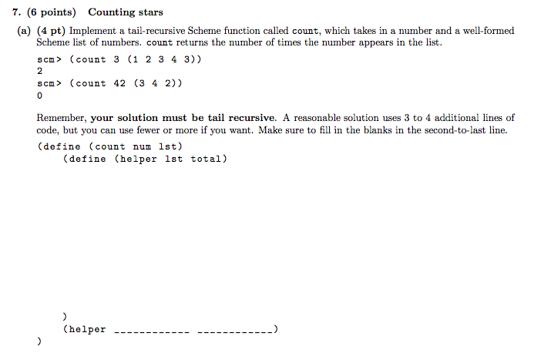
Summer 2015 Final: 7a
Notes:
Mary

Slide 11
Summer 2015 Final: 7a
(cond ((null? lst) total)
((= (car lst) num) (helper (cdr lst) (+ total 1)))
(else (helper (cdr lst) total)))
lst 0
Notes:
Mary

Slide 12
Problem 3: sum-satisfied-k
Implement sum-satisfied-k which, given an input list lst, a predicate procedure f which takes in one argument, and an integer k, will return the sum of the first k elements that satisfy f. If there are not k such elements, return 0. Make sure your implementation is tail recursive!
(define (sum-satisfied-k lst f k)
(define (sum-helper ______________ )
(cond ((= k 0) _______ )
((null? lst) ________)
((____________) (_____________________________________))
(else ___________________________________________))
(______________________________)
)
Notes:
Chae

Slide 13
Problem 2: sum-satisfied-k
Implement sum-satisfied-k which, given an input list lst, a predicate procedure f which takes in one argument, and an integer k, will return the sum of the first k elements that satisfy f. If there are not k such elements, return 0. Make sure your implementation is tail recursive!
(define (sum-satisfied-k lst f k)
(define (sum-helper ______________ )
(cond ((= k 0) _______ )
((null? lst) ________)
((____________) (_____________________________________))
(else ___________________________________________))
(______________________________)
)
lst k total
total
0
f (car lst)
sum-helper (cdr lst) (- k 1) (+ total (car lst))
(sum-helper (cdr lst) k total)
sum-helper lst k 0
Notes:
Chae

Slide 14
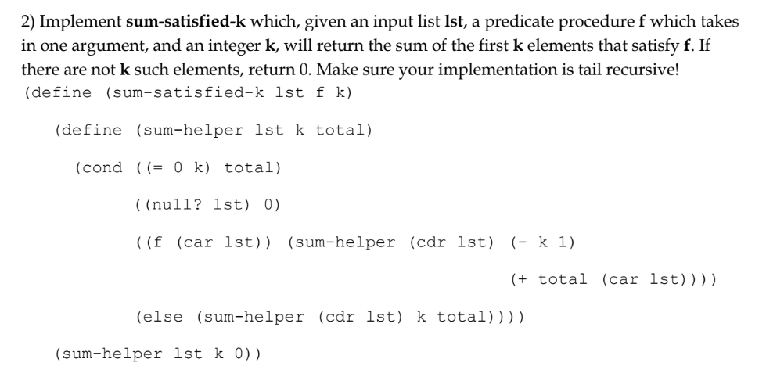
Notes:
Chae

Slide 15
Problem 3: remove-range
Implement remove-range which, given one input list lst, and two integers i and j, returns a new list containing the elements of lst in order, minus the elements from i to j inclusive. For example, given the list (0 1 2 3 4), with i = 1 and j = 3, we would return the list (0, 4). Your implementation must be tail recursive. You may assume j >= i, i is non-negative, and j is less than the length of the list. (Hint: You may want to use the built-in append function)
(define (remove-range lst i j)
(define (remove-tail _________________________)
(cond ((____________) (________________________))
((______________) ( _______________________________________________ ))
(else __________________________________________________________________))
( ____________________________________)
)
Notes:
Mary

Slide 16
Problem 3: remove-range
Implement remove-range which, given one input list lst, and two integers i and j, returns a new list containing the elements of lst in order, minus the elements from i to j inclusive. For example, given the list (0 1 2 3 4), with i = 1 and j = 3, we would return the list (0, 4). Your implementation must be tail recursive. You may assume j >= i, i is non-negative, and j is less than the length of the list. (Hint: You may want to use the built-in append function)
(define (remove-range lst i j)
(define (remove-tail _________________________)
(cond ((____________) (________________________))
((______________) ( _______________________________________________ ))
(else ____________________________________________________________________))
( ____________________________________)
)
lst index sofar
> index j
append sofar lst
>= index i
remove-tail (cdr lst) (+ index 1) sofar
(remove-tail (cdr lst) (+ index 1) (append sofar (list (car lst)))
remove-tail lst 0 nil
Notes:
Mary
#Note: Also was in CSM final review

Slide 17
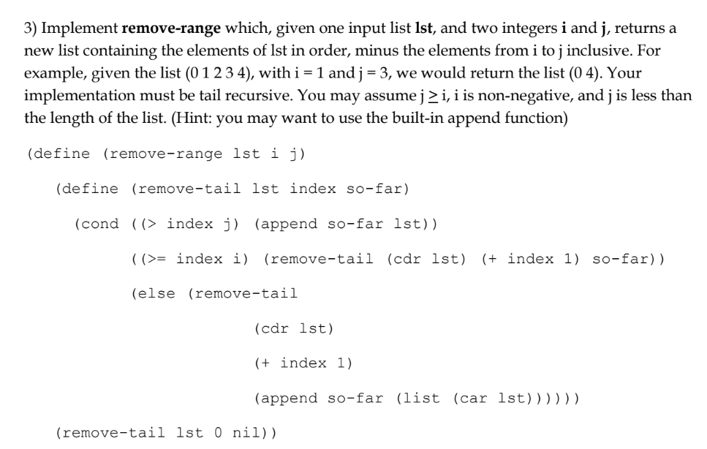
Notes:
Mary

Slide 18
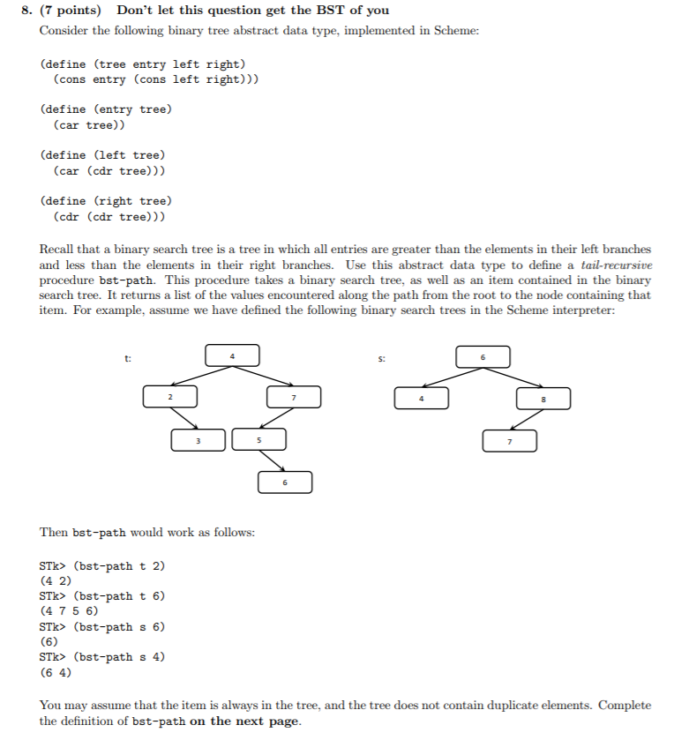
Summer 13 Q8
The given tree is a Binary Search Tree. Use BST to define a tail-recursive procedure bst-path. This procedure takes a BST, as well as an item contained in the BST. It returns a list of the values encountered along the path from the root to the node containing that item. For example, assume we have defined the following BSTs in the scheme interpreter:
Binary Tree ADT in Scheme:
Notes:
Chae

Slide 19
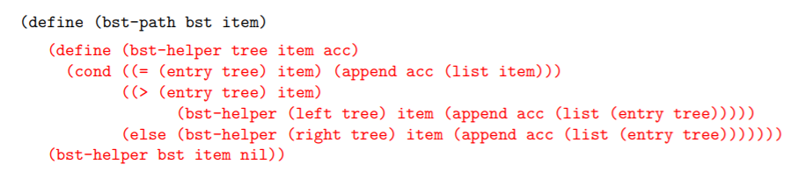
Notes:
Chae

Slide 20
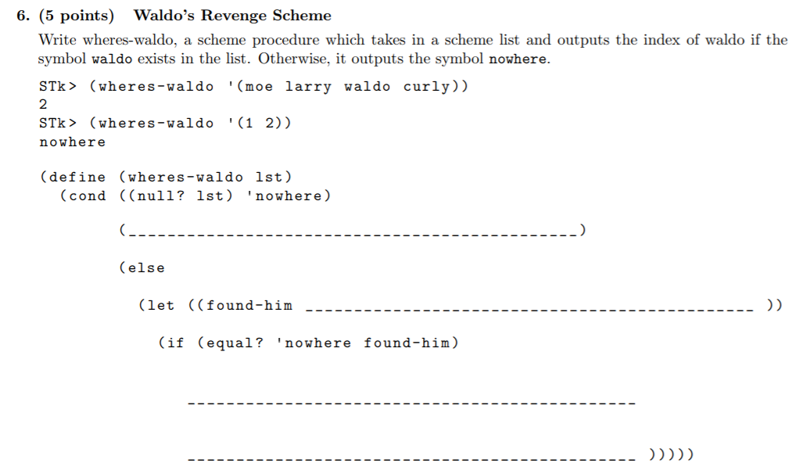
Prequel to waldo question (summer 14 MT2)
Notes:
Duplicate of slide 9

Slide 21
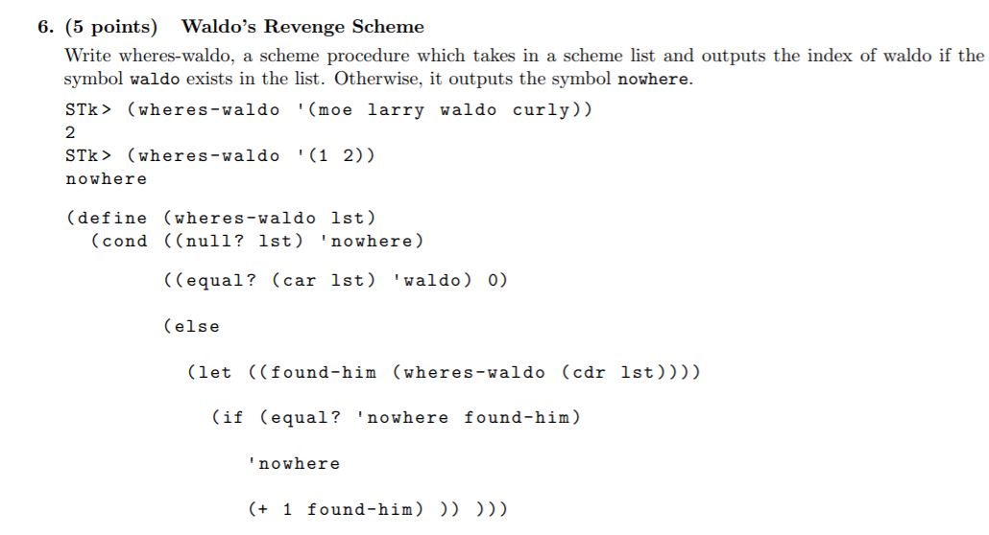

Slide 22
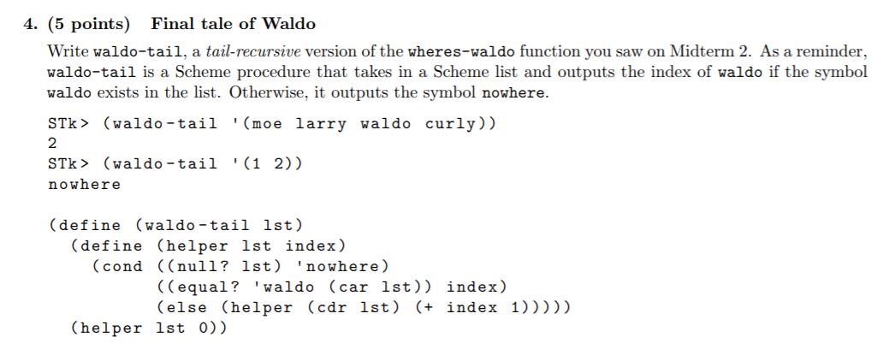

Slide 23
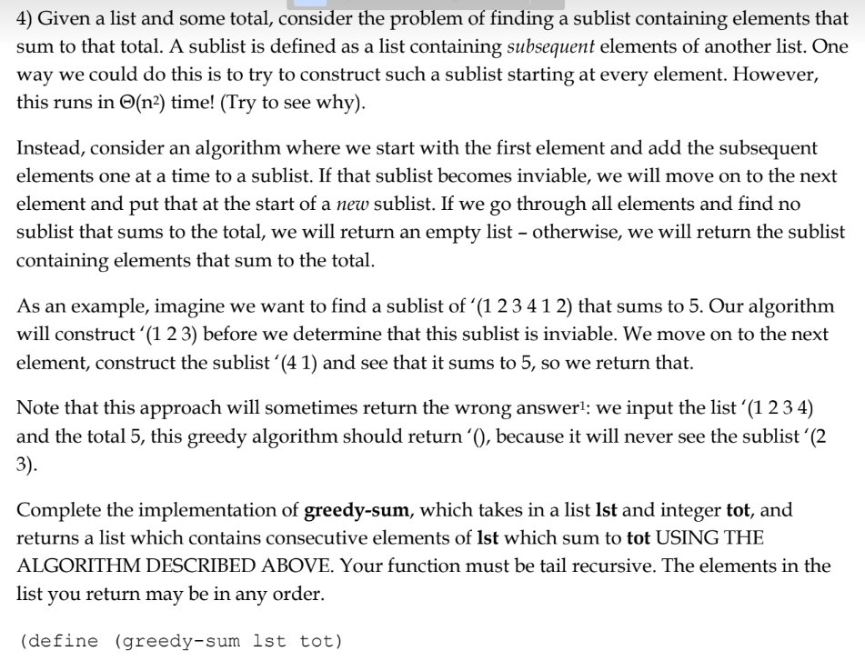
Notes:
This one seems really long oof

Slide 24
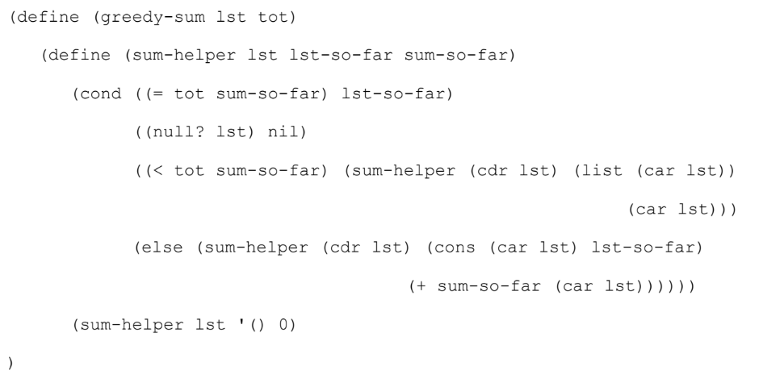

Slide 25
Conclusion
In order for a function to be tail recursive, each recursive call must be tail calls
Tail recursion is iteration! Think as if you are solving a problem using while loop
Define helper function w/ extra parameters as needed!
When constructing some kind of list-so-far using a helper function, be careful of the order!
Use append, cons, or list appropriately
Ex. remove_range (this slide), reverse (discussion 10)
Notes:
Mary

Slide 26
Thanks for coming!
Hope you learned something!
Chae & Mary

